Slide 1



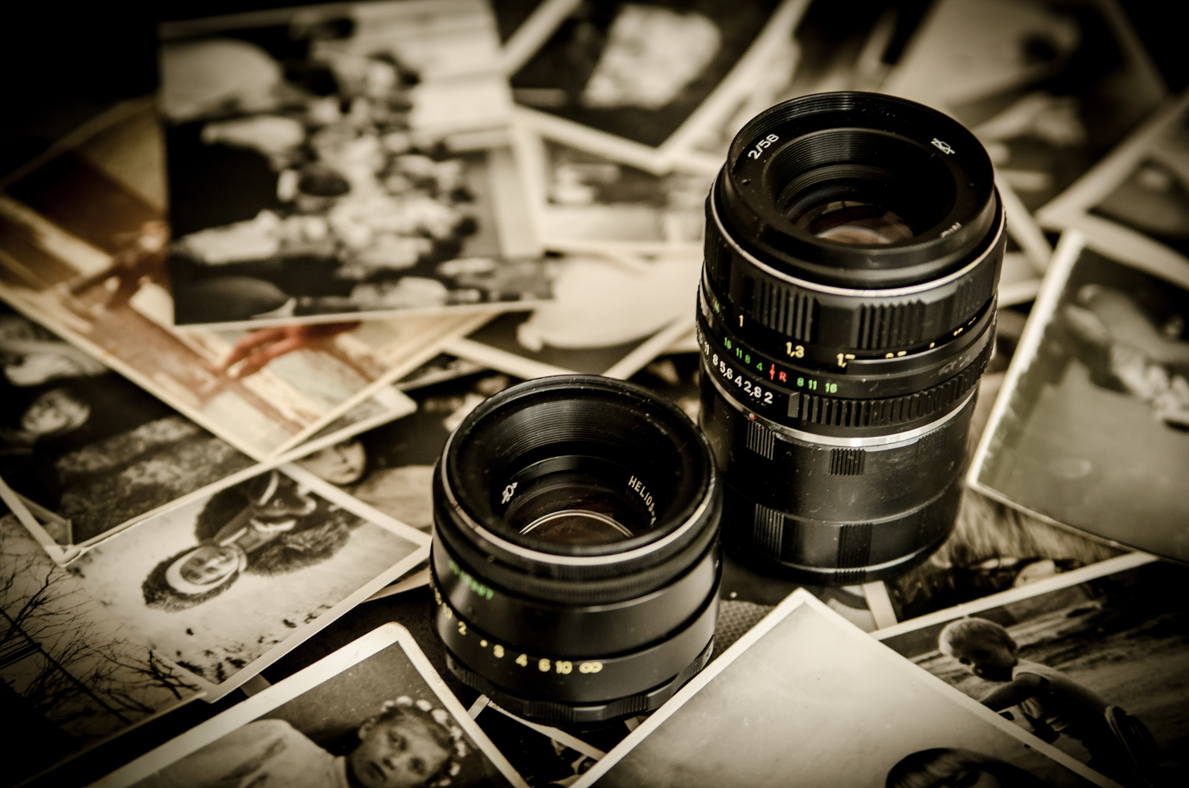


IMAGE
COMPRESSION
Understanding how image compression works
Group Presentation

Slide 2
FRACTAL
COMPRESSION

Slide 3
INTRODUCTION
Welcome to the world of image compression, where efficiency meets visual fidelity!
In this presentation, we delve into the realm of fractal image compression . We'll explore the principles, implementation process, performance metrics, and showcase results through demonstrations and examples.
Among various compression methods, fractal compression stands out for its ability to exploit self-similarity within images, offering promising results in terms of compression ratios and quality retention.
In the digital age, managing vast amounts of visual data efficiently is crucial. Image compression techniques play a pivotal role in reducing file sizes while preserving image quality.

Slide 4

1. Overview of Objectives: Our primary objective is to provide a comprehensive understanding of fractal image compression and its implementation using Python.
2. Exploration of Fractal Compression: We aim to delve into the intricacies of fractal compression, elucidating its underlying principles and showcasing its effectiveness in reducing image file sizes.
3. Implementation Insights: Through detailed explanation and examples, we seek to elucidate the implementation process of fractal compression algorithms, highlighting key functions and methodologies utilized in Python.
4. Performance Evaluation: We intend to evaluate the performance of our fractal compression implementation, comparing compression ratios, image quality, and computational efficiency with traditional compression techniques.
5. Demonstration and Discussion: Lastly, we aim to demonstrate the capabilities of our implementation through practical examples and engage in a discussion regarding its potential applications, challenges, and future directions.
OBJECTIVES

Slide 5
BACKGROUND
TRADITIONAL IMAGE COMPRESSION:
Image compression techniques aim to reduce the storage space required for digital images while maintaining perceptual quality. Traditional methods like JPEG and PNG rely on spatial redundancy reduction and quantization.
INTRODUCTION TO FRACTAL COMPRESSION:
Fractal compression is a novel approach that exploits the self-similarity present in natural images. It employs iterated function systems (IFS) to iteratively transform and approximate image regions, achieving high compression ratios with minimal loss of quality.
ADVANTAGES OF FRACTAL COMPRESSION:
Fractal compression offers several advantages over traditional methods, including superior compression ratios, scalability, and the ability to preserve intricate details and textures in images. These attributes make it particularly suitable for applications where both efficiency and visual fidelity are paramount.

Slide 6
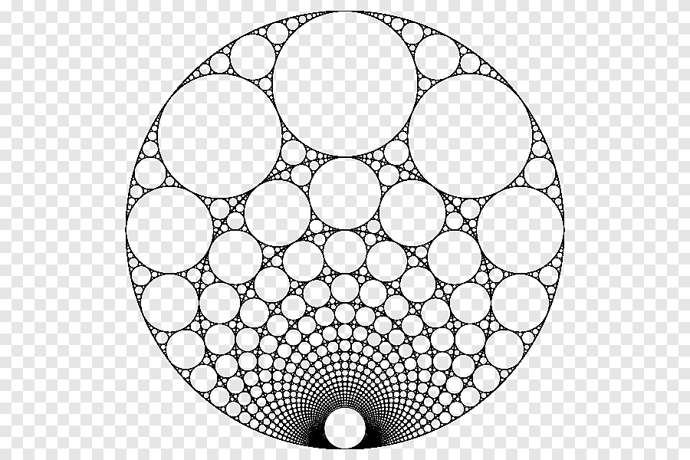
FRACTAL IMAGE COMPRESSION
1. Principles of Fractal Compression: Fractal compression leverages the concept of self-similarity within images, where smaller portions of an image resemble the larger whole. By identifying and exploiting these similarities, fractal compression algorithms can represent images using a compact set of transformation parameters.
2. Iterated Function Systems (IFS): At the core of fractal compression is the concept of iterated function systems (IFS), which consists of a set of affine transformations applied iteratively to generate fractal-like structures. These transformations are used to approximate image regions, enabling efficient encoding and decoding processes.
3. Self-Similarity and Image Representation:Self-similarity refers to the property of an image where smaller regions exhibit similar patterns or structures as larger regions. Fractal compression capitalizes on this property to represent images using a hierarchical structure of self-similar transformations, enabling high compression ratios while preserving visual quality.

Slide 7
IMPLEMENTATIONOVERVIEW
1. Fractal Compression Implementation:
Our implementation of fractal image compression is built using Python, leveraging libraries such as NumPy, SciPy, and Matplotlib for efficient computation and visualization.
2. Key Components and Functions:
The implementation comprises various components and functions designed to manipulate images, apply transformations, adjust contrast and brightness, and perform compression and decompression operations.
3. Modular Design Approach:
To ensure modularity and ease of maintenance, we have structured the implementation into separate modules, each responsible for specific tasks such as image manipulation, transformation estimation, and compression optimization.
4. Flexibility and Extensibility:
The implementation is designed to be flexible and extensible, allowing for easy integration of additional features, optimization techniques, and customization options to adapt to different use cases and image types.

Slide 8
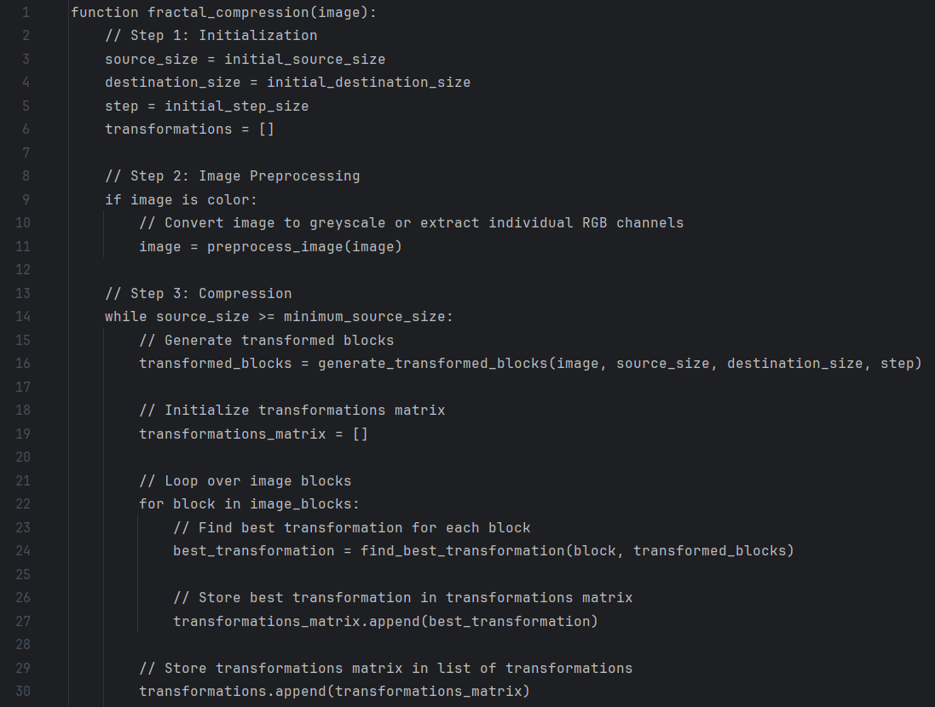
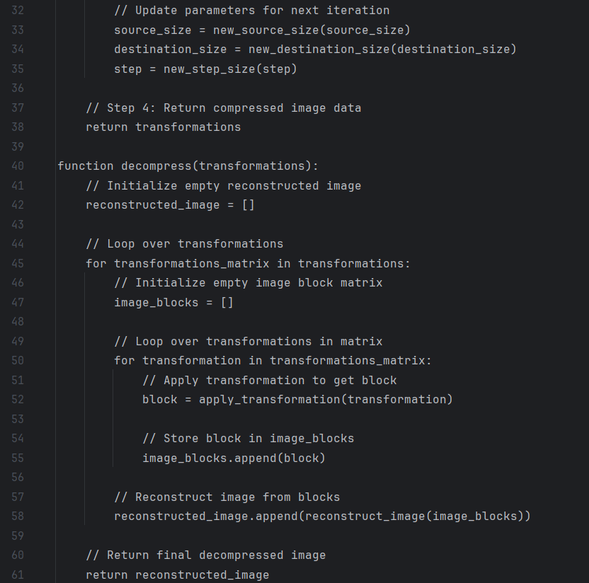
PSEUDOCODE

Slide 9
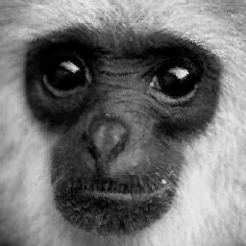

GREYSCALE IMAGE
BEFORE COMPRESSION
AFTER COMPRESSION

Slide 10
GREYSCALE IMAGE
BEFORE COMPRESSION
The size of image before compression was 74 KB
AFTER COMPRESSION
The size of the image after compression was 2 KB
1. Efficient Storage: Greyscale compression reduces the storage space required for images, making it ideal for storing large collections of greyscale images in a compact format.
2. Minimal Loss of Quality: Despite compression, greyscale images maintain their essential details and textures, ensuring that critical visual information remains intact.
3. Fast Processing: Fractal compression techniques enable rapid processing of greyscale images, making them suitable for applications requiring real-time analysis and transmission of visual data.

Slide 11


RGB IMAGE
BEFORE COMPRESSION
AFTER COMPRESSION

Slide 12
RGB IMAGE
BEFORE COMPRESSION
The size of image before compression was 223 KB
AFTER COMPRESSION
The size of the image after compression was 2 KB
Color Preservation: RGB image compression retains the color fidelity of images while reducing file size, ensuring that the original hues and tones are preserved even after compression.
Multi-Channel Optimization: Fractal compression techniques optimize each RGB channel independently, allowing for efficient compression of color images without compromising on image quality.
Versatile Applications: RGB image compression is suitable for a wide range of applications, including digital photography, graphic design, and multimedia communication, where preserving color accuracy is essential for conveying visual information effectively.

Slide 13
HUFFMAN
COMPRESSION

Slide 14
INTRODUCTION
Welcome to the world of image compression, where efficiency meets visual fidelity!
Huffman's method efficiently reduces file sizes by assigning shorter codes to frequently occurring image intensities, optimizing storage and transmission resources.
Huffman compression is versatile, suitable for various image types and formats, making it indispensable across multimedia, telecommunications, and medical imaging sectors.
Image quality remains intact post-compression, ensuring essential visual details are retained, making it ideal for applications requiring high-fidelity images.

Slide 15
1. Maximize Compression Ratio: The primary objective of Huffman image compression is to achieve the highest compression ratio possible while maintaining image quality. By efficiently encoding image intensities based on their frequencies, the algorithm aims to significantly reduce file sizes.
2. Ensure Image Fidelity: Another key objective is to preserve the fidelity of the original image during compression and decompression. It's essential to reconstruct the image accurately from the compressed data, ensuring that important visual information remains intact.
3. Optimize Execution Time: Huffman compression seeks to minimize the time required for both encoding and decoding processes. Efficient algorithms and data structures are employed to streamline these operations, enabling fast compression and decompression of images.
4. Enhance Versatility: The compression technique aims to be adaptable to various image types, sizes, and formats. By providing a flexible solution, it can cater to diverse applications and environments where image compression is required.
5. Facilitate Integration: Integration into existing systems and workflows is also an objective. Huffman compression should be easily implementable and compatible with different platforms and software environments, ensuring seamless adoption and usage.
OBJECTIVES

Slide 16
BACKGROUND
1. Digital Imaging Challenges: As digital imaging technologies advance, the need for efficient data compression grows. Balancing compression ratios with image fidelity poses a challenge, as traditional methods often sacrifice one for the other.
2. Huffman's Solution: Huffman compression, pioneered by David A. Huffman in 1952, offers a solution by encoding image data based on intensity frequency. This approach achieves significant file size reductions while preserving image quality.
3. Efficiency and Impact: Huffman compression's effectiveness lies in its ability to prioritize common image elements for shorter codes. This technique has widespread applications in multimedia, telecommunications, and medical imaging, streamlining storage, transmission, and analysis of visual data.

Slide 17

HUFFMAN IMAGE COMPRESSION
1. Efficient Data Reduction: Huffman image compression optimizes file sizes by assigning shorter binary codes to frequently occurring pixel intensities in digital images. This prioritization ensures that common intensities are represented by fewer bits, leading to significant reductions in storage requirements.
2. Preservation of Visual Quality: Despite the reduction in file size, Huffman compression maintains image fidelity by accurately reconstructing the original image from the compressed data. By encoding pixel intensities based on their frequencies, the algorithm ensures that important visual details and features are retained, resulting in minimal loss of image quality.
3. Versatile Application: Huffman image compression finds widespread application across various fields, including multimedia, telecommunications, and medical imaging. Its ability to efficiently compress image data without compromising visual quality makes it invaluable for tasks such as image storage, transmission, and analysis, where both efficient use of resources and preservation of image integrity are crucial.

Slide 18
1. Input Processing:
- Read and process input image data.
2. Huffman Tree Construction:
- Build a binary tree based on intensity frequencies.
3. Encoding:
- Assign Huffman codes to intensities.
4. Compression:
- Generate compressed binary data.
5. Decoding:
- Reconstruct original data from compressed binary.
6. Output Generation:
- Create output file with reconstructed image.
7. Performance Evaluation:
- Assess compression ratio and execution time.
8. Integration and Deployment:
- Integrate into systems and deploy for image compression tasks.
IMPLEMENTATIONOVERVIEW

Slide 19
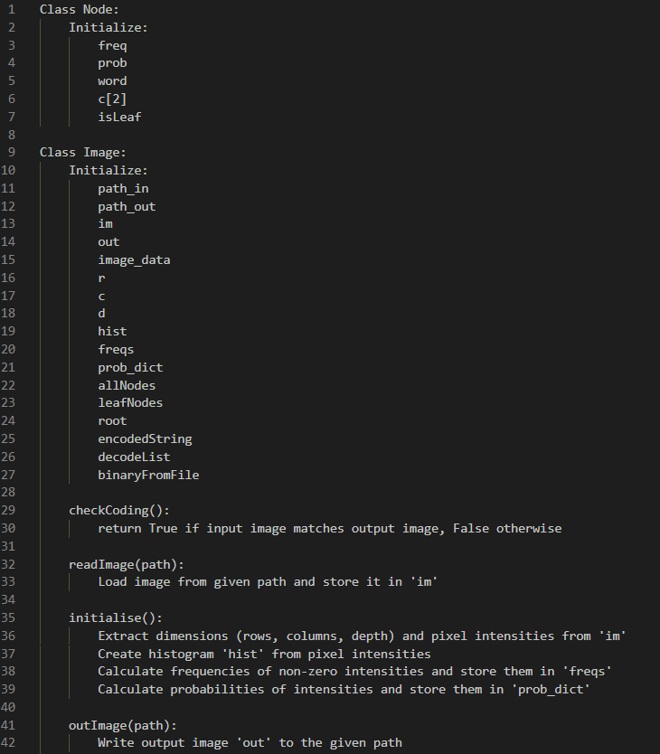
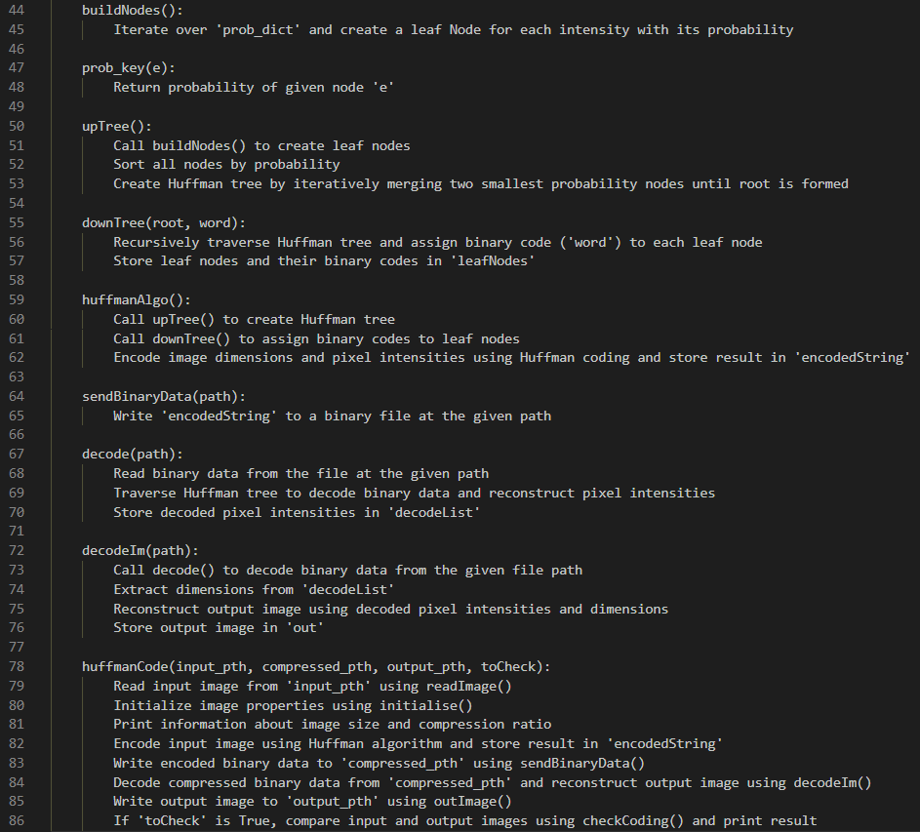
PSEUDOCODE

Slide 20


OUTPUT
BEFORE COMPRESSION
AFTER COMPRESSION

Slide 21
OUTPUT
BEFORE COMPRESSION
The size of image before compression was 3,617 KB
AFTER COMPRESSION
The size of the image after compression was 1,774 KB
Reconstructed Image: The reconstructed image, generated from the decoded compressed data, demonstrates the effectiveness of the Huffman compression algorithm in preserving image quality while reducing file size.
Output File: The output file containing the reconstructed image is available for further analysis, visualization, or integration into existing systems.
Performance Evaluation: Evaluation metrics such as compression ratio and execution time provide insights into the efficiency and effectiveness of the compression and decompression processes.

Slide 22

OTHER COMPRESSION METHODS
1. JPEG Compression:
- JPEG (Joint Photographic Experts Group) compression is a widely used method for compressing digital images.
- It's a lossy compression technique, meaning some image data is discarded to reduce file size.
- JPEG works by dividing the image into small blocks of pixels, applying the Discrete Cosine Transform (DCT) to each block, and then quantizing the transformed coefficients.
- The quantization process introduces loss by rounding off the coefficients, and this loss can be controlled by adjusting the compression level.
- It's efficient for compressing photographs and natural images with smooth color gradients.

Slide 23
OTHER COMPRESSION METHODS
2. Wavelet Compression:
- Wavelet compression is another form of lossy compression used for digital images.
- It's based on wavelet transforms, which decompose the image into multiple levels of frequency bands.
- Wavelet compression can achieve higher compression ratios than JPEG while maintaining good image quality.
- It works by representing the image as a set of wavelet coefficients at different scales and orientations.
- By discarding or quantizing less important coefficients, wavelet compression reduces the file size while preserving image details.
- Wavelet compression is suitable for a wide range of image types, including photographs, medical images, and satellite images.

Slide 24
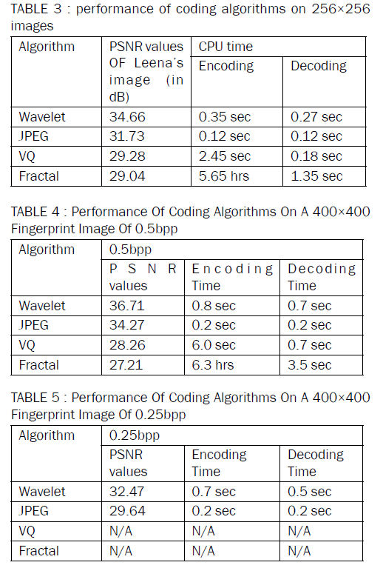
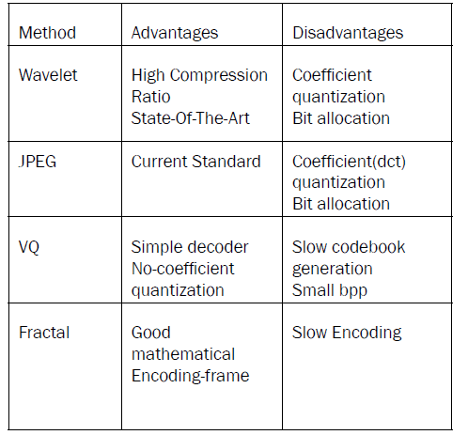
OTHER COMPRESSION METHODS

Slide 25
TO CONCLUDE
Summary of Key Findings:
Fractal image compression offers a promising approach to efficiently reduce the file size of images while maintaining visual quality.
Through our implementation, we have demonstrated the effectiveness of fractal compression in achieving high compression ratios with minimal loss of image fidelity.
Achievements and Outcomes:
We have successfully developed and implemented a fractal compression algorithm using Python, leveraging libraries such as NumPy, SciPy, and Matplotlib.
Our algorithm showcases the potential of fractal compression in various applications, including greyscale and RGB image compression.
Acknowledgments:
We extend our gratitude to our Professor Dr. Shoba LK for their guidance and support throughout the development and presentation of this project.
We also thank our peers and colleagues for their valuable feedback and contributions.

Slide 26

THAT'S A WRAP!
PRESENTED BY:-
KUSHAGRA MALVIYA [RA2211003011338]
DWIJ BISHNOI [RA2211003011316]
ASHUTOSH SHARMA [RA2211003011350]

